Slide 1
Victoria Legal Aid Client Satisfaction Survey 2015.

Slide 2
Background
Colmar Brunton was commissioned by Victoria Legal Aid (VLA) to conduct research into client satisfaction in the areas of Civil, Criminal, and Family Law for the Legal Advice, Casework, and Duty Lawyer services as well as the Legal Help service.
The overall purpose of the research is to assess the quality of VLA’s performance in service delivery from the client’s perspective and target areas of service improvement.
The objectives of the research were to:
Find out more about clients and their perceptions of VLA services;
Help VLA make decisions about the services provided;
Be able to report findings to government and stakeholders; and

Slide 3
Methodology
In 2015, Colmar Brunton utilised a mixed-methodology approach to data collection with n=562 x 15 minute Computer Assisted Telephone Interviews (CATI) and n=442 clients completing the survey online. A total of n=1,004 clients were surveyed, and had used one or more of the following VLA services:
Legal Advice n=339
Casework n=352
Duty Lawyer n=345
Legal Help n=129
Note: Data from previous surveys is included where relevant.
Arrows in tables refer to significant differences or changes from previous years.

Slide 4
Key Take Outs.

Slide 5
Key Take Outs
1.
Most clients indicated that the manner of the legal expert they consulted with was of high quality.
What showed opportunities for improvement was ensuring the client understood and trusted the information provided, and were kept informed throughout the process.
While satisfied overall, Duty Lawyer clients were more likely to be dissatisfied with waiting times at court and to report feeling rushed by their lawyer.
This service type should be prioritised for further investigation to improve service delivery and performance.
2.
3.
Some Aboriginal clients were less likely to be satisfied with VLA services (note, small sample size of 22). Aboriginal clients were also less inclined to use the same lawyer again in the future, and were less satisfied with the intake and assessment process
4.
Clients for whom English was not a first language or who had a disability reported having more difficulty with the intake and assessment process. These clients were more likely to report difficulty in communicating with staff and with comprehending the information that was provided during intake.

Slide 6
Detailed Findings.

Slide 7
Overall Satisfaction with VLA.

Slide 8
In 2015, overall satisfaction with Legal Aid has improved on 2013, but remains below that of 2011 & 2012.
But…
Overall satisfaction with VLA remains high with 76% of all clients stating that they were either satisfied or very satisfied with VLA.
% satisfied
76%
73%
87%
86%
Q7Q Overall, how would you rate your satisfaction with Legal Aid? (SR)
Base: All survey participants

Slide 9
Family Law clients showed an improvement with their satisfaction with VLA since 2013, but overall satisfaction declined for both Civil Law and Criminal Law clients since the last time they were surveyed.
Criminal Law clients were significantly more satisfied with VLA than Family and Civil Law clients.
% satisfied
72%
69%
81%
73%
77%
85%
81%
87%
89%
Q7Q Overall, how would you rate your satisfaction with Legal Aid? (SR)
Base: 2013 – all Family Law and Civil Law clients who, according to VLA, accessed either Legal Advice, Casework or Duty Lawyer services. 2011 – Family Law and Civil Law clients (excluding clients who were both Family and Civil Law clients) that accessed either Legal Advice, Casework or Duty Lawyer services.
Note: * indicates data from 2012

Slide 10
Casework and Duty Lawyer clients recorded improvements in their satisfaction with Legal Aid over 2013, while Legal Advice and Legal Help clients remained largely unchanged.
Casework clients were significantly more satisfied with VLA than Legal Advice and Duty Lawyer service areas.
% satisfied*
72%
70%
84%
85%
75%
91%
75%
72%
85%
78%
79%
87%
Q7Q Overall, how would you rate your satisfaction with Legal Aid? (SR)
Base: All survey participants

Slide 11
Gaps in perceived importance and satisfaction.

Slide 12
Findings from the survey were subject to a ‘gap analysis’ whereby the perceived importance of an element of VLA’s services was contrasted to client satisfaction.
The greatest gaps in importance/ satisfaction were seen for information-based statements such as:
“The staff are knowledgeable”;
“I’m kept informed about what’s going on throughout the process”;
“I have a better understanding of my legal options”;
“I can trust the information I’m given”.

Slide 13
When looking at the different service types, priority areas for improvement are:
Legal Help
Tailoring information for clients to be more helpful, instilling trust in the information given, and making sure clients understand their legal options or the steps they need to take next.
Legal Advice
Duty Lawyer
Casework
Instilling trust in the information given, increasing the perception that staff/ the lawyer are knowledgeable and competent, and keeping clients informed about what’s happening throughout the process.

Slide 14
Suggested Improvements to Service.

Slide 15
The most commonly cited areas of improvement across all clients surveyed suggested the service they received felt underfunded, that they didn’t get enough time with the service providers and the service was too difficult to access.
More staff / lawyers / less waiting / all day service (10%)
More resources / government funding / easier to access / more services and bigger range / regional areas (7%)
Spend more time with you / less rushed (5%)
Give clear instructions / information correct / appropriate / explain what has happened / what to do in court (5%)
Q7R How could Legal improve their service? (OE)
Base: All survey participants (n=1004)

Slide 16
The main issues identified by clients who were dissatisfied with VLA’s service were more to do with issues in communication and relations between them and their lawyer.
“
I could not find anyone to help me and I went to court with no help at all and was given an order against me because I had no clue how to conduct my defence.”
“
Better funding, better resourced, better infrastructure and better assistance, and more staff.”
Comments from dissatisfied clients
“
Have people who care, who are knowledgeable, who give you time.”
“
Give correct information, lawyer gave me false information. No help at all with my case - seemed like they couldn't be bothered with me.”
“
Be sympathetic, understanding, willing to take the time to listen to the issues. Not being so dismissive. Being compassionate. Willing to take the time to understand the issue, meet with the client and offer the appropriate support and advice.”
Q7R How could Legal improve their service? (OE)
Base: Dissatisfied clients (n=132)

Slide 17
Client Expectations.

Slide 18
Getting through to the right person when calling VLA was rated as the most important expectation related to accessing VLA, followed by not having to repeat their story.
Expectation of accessing VLA
Mean
8.5
8.2
7.9
7.5
Q1G. Now I’ll ask you a few questions about what you expect from Victoria Legal Aid. How important are each of the following to you? Please rate each item using a scale from 0 (not at all important to 10 extremely important). Base: All 2015 respondents (n=1,004)

Slide 19
Trusting the information given, being treated with respect, and understanding the information given were rated as the most important aspects of VLA’s service.
Expectation of VLA’s service
Mean
9.3
9.2
9.2
9.1
9.2
8.9
8.8
8.3
8.5
Q1H. When you think about the service provided by Legal Aid, how important are the following to you? Please rate each item using a scale from 0 (not at all important) to 10 (extremely important). Base: All 2015 respondents (n=1,004)

Slide 20
Clients rated having a better understanding of their legal options and their legal problem getting resolved as the most important expected outcomes when receiving a VLA service.
Expectation of Outcome
Mean
9.0
9.0
8.6
7.6
Q1I. Now, thinking about the outcome you expect when you receive a Legal Aid service, using a scale from 0 (not at all important) to 10 (extremely important) how important are the following? Base: All 2015 respondents (n=1,004)

Slide 21
Access to VLA.

Slide 22
The most common way clients first heard about VLA was through court, from friends and family and by word of mouth. Only 5% of clients first heard about VLA through the Legal Aid website, while 2% first heard about VLA through the Media.
Q1A How did you first hear about Victoria Legal Aid? Base: All 2015 respondents (n=1,004)
Note: Only responses mentioned by 2% or more respondents charted

Slide 23
One in five clients found it hard to get help from VLA due to their circumstances, with common reasons including not qualifying for help, too busy/not enough time to help and VLA already dealing with the other party/conflict of interest.
22%
Found it hard to get help from VLA
Q1Q. Was it hard to get help from Legal Aid due to your circumstances?
Base: All 2015 respondents (n=1,004)
Q1R. Why was it hard to get help from Legal Aid?
Base: Clients who had difficulties getting help from VLA (n=217)
Note: Only responses mentioned by 2% or more respondents charted

Slide 24
Client’s experience with the staff member that conducted their assessment was generally very positive. The highest rated aspects of the staff member’s service was that clients were able to fully explain their situation and were satisfied with the type of questions asked by the staff member during the assessment.
% Agree
86%
86%
83%
83%
81%
81%
Q1L. I’m going ask you how much you agree or disagree with some statements about the Victoria Legal Aid staff member who assessed you. Do you agree or disagree … Base: Respondents who recall being assessed in person, over the phone, via the Legal Help service or at a court or tribunal (n=645)

Slide 25
Most clients stated that the intake process was easy, with 75% of clients reporting their assessment and intake process as easy or very easy, with only 10% reporting the process as difficult or very difficult.
% easy
75%
70%
75%
79%
76%
Q1M. Overall, how easy or difficult was the assessment and intake process? Base: Respondents who recall being assessed in person, over the phone, via the Legal Help service or at a court or tribunal (n=645)

Slide 26
Client satisfaction with the assessment and intake process was high, with 79% of clients satisfied or extremely satisfied with the process, and only 11% dissatisfied or extremely dissatisfied.
% satisfied
79%
75%
81%
80%
81%
Q1O. Overall, how satisfied were you with this process? Base: Respondents who recall being assessed in person, over the phone, via the Legal Help service or at a court or tribunal (n=645)

Slide 27
Emotional Impact of Legal Problems.

Slide 28
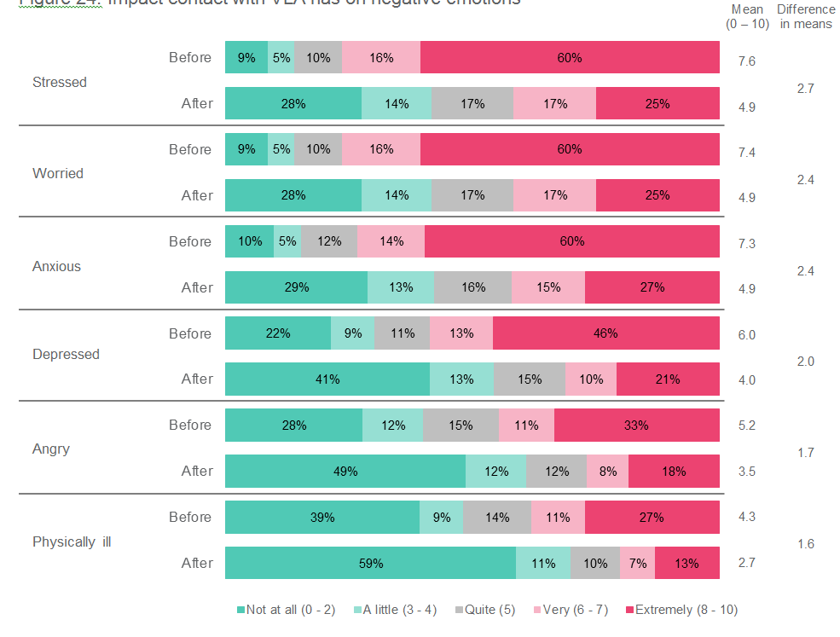
Obtaining help from VLA for a legal problem significantly improved how clients rated their negative emotions, with the largest reductions seen for stress and worry after obtaining help from VLA.
Impact of VLA contact on emotional wellbeing
Q2K, Q3K, Q4K, Q5K: Before you got help from VLA, how did you feel about your legal problem?
Q2L, Q3L, Q4L, Q5L: After you got help from VLA, how were you feeling about your legal problem?
Base: Respondents who recall receiving a service (n=911)

Slide 29
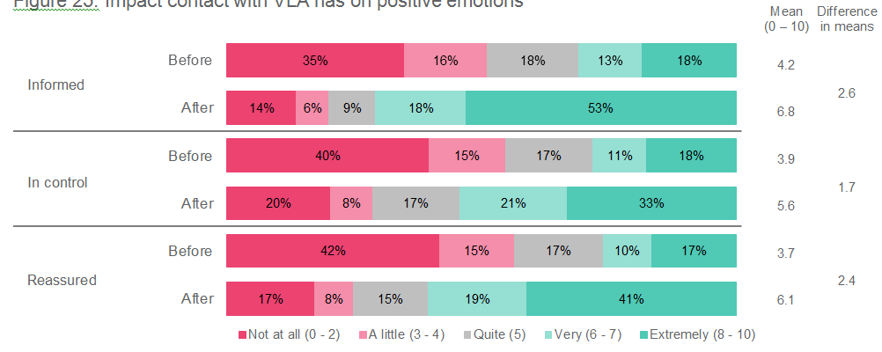
Obtaining help from VLA significantly improved clients’ emotional wellbeing, with the largest improvements to feelings of being informed and reassured about their legal problem.
Q2K, Q3K, Q4K, Q5K: Before you got help from VLA, how did you feel about your legal problem?
Q2L, Q3L, Q4L, Q5L: After you got help from VLA, how were you feeling about your legal problem?
Base: Respondents who recall receiving a service (n=911)

Slide 30
Legal Advice Service.

Slide 31
Criminal Law clients were most likely to use the same lawyer again if they were in a similar situation, with four in five agreeing compared to three in five for Family Law and Civil Law clients.
Legal Advice
Q2F_8 If you had a similar situation in the future would you like to use the same lawyer again? (SR)
Base: All Legal Advice clients who recalled using the service

Slide 32
When looking at the service provided by Legal Advice Lawyers, clients were generally very positive across all aspects of their service, with the below statements reflecting the highest and lowest ratings (relative):
Legal Advice
✓

Highest rated statements (>80% agree)
Lowest rated statements (<75% agree)
The lawyer was polite and respectful The lawyer listened to you The lawyer helped you to understand the legal situation you were in
You were kept informed throughout the process You felt confident in your Lawyer 's ability
Q2F. I’m going to read out some statements about the lawyer you spoke with and ask you to say how much you agree or disagree with each statement. Do you, strongly disagree, disagree, agree or strongly agree that…? (SR)
Base: All Legal Advice clients who recalled using the service (n=310) * Wording variation in 2011: the service you received was what you expected

Slide 33
Criminal Law clients were the most likely to recommend the Legal Advice service provided by VLA, with nine in ten indicating they would do so, followed by eight in ten Civil Law clients and three quarters of Family Law clients.
Legal Advice
Q2J. Would you recommend the Victoria Legal Aid advice service to other people? (SR)
Base: All Legal Advice clients who recalled using the service

Slide 34
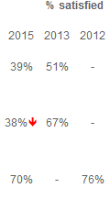
A higher proportion of Criminal Law clients were also satisfied with the outcome of their case when compared to Family and Civil Law clients.
Legal Advice
Q2H How satisfied were you with the outcome of your legal problem? (SR)
Base: All Legal Advice clients who recalled using the service

Slide 35
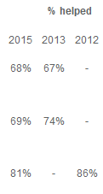
Of all three service areas, Criminal Law clients were most likely to indicate that the legal advice they received helped.
Legal Advice
Q2G. To what extent did legal advice help you to sort out your legal problem? (SR)
Base: All Legal Advice clients who recalled using the service

Slide 36
Casework Service.

Slide 37
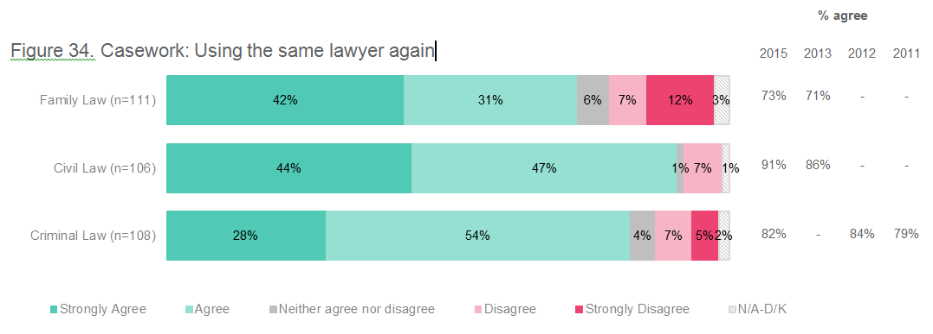
Civil Law clients were most likely to agree that they would use the same lawyer again in the future if they had a similar situation, followed by Criminal Law clients, and almost three quarters of Family Law clients.
Casework
Q3F_9 If you had a similar situation in the future would you like to use the same lawyer again? (SR)
Base: All Casework clients who recalled using the service

Slide 38
Casework
The majority of all VLA Casework clients were very satisfied with the service provided by their lawyer, with the below statements reflecting the highest and lowest ratings (relative):
✓

Highest rated statements (>90% agree)
Lowest rated statements (<85% agree)
The lawyer was polite and respectful The lawyer listened to you The lawyer helped you to understand the legal situation you were in The advice you received was helpful The lawyer explained what the legal aid grant was for and what information you needed to provide
If you had a court, tribunal or commission hearing, the lawyer helped you prepare for this
Q3F. I’m going to read out some statements about how your lawyer represented you and again ask you to say how much you agree or disagree with each statement. Do you, strongly disagree, disagree, agree or strongly agree that…? (SR) Base: All Family (n=111), Civil (n=106) and Criminal (n=108) law clients who recalled using the Casework service * Wording variations from previous years. “the service you received was what you expected” and “the lawyer helped you prepare for the court appearance”.

Slide 39
The use of a VLA salaried vs private lawyer had very little impact on a clients’ satisfaction with VLA, with 86% of those that used a VLA salaried lawyer satisfied compared to 84% of those who used a private lawyer.
Casework
% Satisfied
86%
84%
77%
79%
89%
81%
92%
91%
Q7Q. Overall how would you rate your level of satisfaction with Legal Aid? (SR)
Base: All Casework survey respondents

Slide 40
A large majority of Casework clients indicated they would recommend this service to other people, which was notably higher for both Criminal Law and Civil Law clients.
Casework
Q3J. Would you recommend the Victoria Legal Aid Casework service to other people? (SR)
Base: All Casework clients who recalled using the service

Slide 41
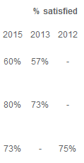
Civil Law clients were the most satisfied with the outcome of their case, followed by Criminal Law clients, and 60% of Family Law clients satisfied with the outcome.
Casework
Q3H How satisfied were you with the outcome of your case? (SR)
Base: All Casework clients who recalled using the service

Slide 42
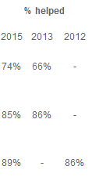
Criminal Law and Civil Law clients tended to be more likely to agree that the Casework service helped them sort out their legal problem, while three quarters of Family Law clients agreed the service helped them.
Casework
Q3G. To what extent did the Casework service help you to sort out your legal problem? (SR)
Base: All Casework clients who recalled using the service

Slide 43
Three quarters of Civil Law and Criminal Law clients indicated the outcome of their case reflected what they were told by their lawyers, higher than Family Law clients.
Casework
Q3N. Did the outcome of your legal problem reflect what you were told by your lawyer? (SR)
Base: All Casework clients who recalled using the service

Slide 44
Duty Lawyer Service.

Slide 45
The majority of clients agreed that is was easy to locate a Duty Lawyer at court. Of the very small proportion that did find it difficult to locate the Duty Lawyer, most said that this was due to the lawyers being busy or understaffed and because they did not know where to go.
Duty Lawyer
Q4B1 Was it easy or difficult to locate the Duty Lawyer at court? (SR)
Base: All Duty Lawyer clients who recalled using the service

Slide 46
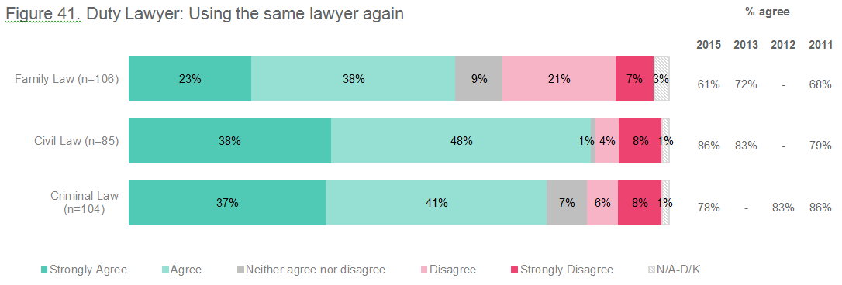
Civil Law clients were most likely to use the Duty Lawyer service again if they were in a similar situation.
Duty Lawyer
Q4F_9 If you had a similar situation you would like to use the Duty Lawyer service again (SR)
Base: All Duty Lawyer clients who recalled using the service

Slide 47
Duty Lawyer
Duty Lawyer clients were mostly positive toward VLA, with the below statements reflecting the highest and lowest ratings (relative):
✓

Highest rated statements (>80% agree)
Lowest rated statements (<70% agree)
The lawyer was polite and respectful The lawyer listened to you The lawyer clearly explained to you what you needed to do next, if anything The lawyer helped you to understand the legal situation you were in
You didn’t have to wait too long to see the lawyer The lawyer didn’t rush you
Q4F. I’m going to read out some statements about the help the Duty Lawyer provided you and ask you to say how much you agree or disagree with each statement. (SR)
Base: All Duty Lawyer clients who recalled using the service (n=235) * wording variation in previous years “The service you received was what you expected”.

Slide 48
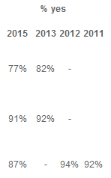
The majority of clients accessing the Duty Lawyer service were happy to recommend the service to others, with Civil Law clients the strongest advocates of VLA’s Duty Lawyer service.
Duty Lawyer
Q4J. Would you recommend the Victoria Legal Aid Duty Lawyer service to other people? (SR)
Base: All Legal Advice clients who recalled using the service

Slide 49
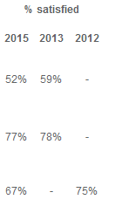
Though the majority of clients were satisfied with the outcome of their legal problem, satisfaction was highest for Civil Law clients.
Duty Lawyer
Q4H How satisfied were you with the outcome of your legal problem? (SR)
Base: All Duty Lawyer clients who recalled using the service

Slide 50
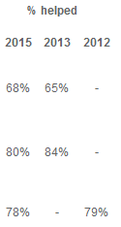
Most clients agreed the Duty Lawyer service helped them, though agreement was higher for Civil and Criminal Law clients.
Duty Lawyer
Q4G. To what extent did the Duty Lawyer service help you to sort out your legal problem? (SR)
Base: All Duty Lawyer clients who recalled using the service

Slide 51
Over 70% of both Family and Civil Law clients said that the outcome of their legal problem reflected what they were told, followed by 60% of Criminal Law clients.
Duty Lawyer
Q4N. Did the outcome of your legal problem reflect what you were told by your lawyer? (SR)
Base: All Duty Lawyer clients who recalled using the service

Slide 52
Legal Help.

Slide 53
When asked if they would use the same adviser again, 76% either agreed or strongly agreed which is a slight decrease since previous years. However, it is important to observe a continued increase in clients who strongly agree.
Legal Help
% agree
76%
79%
82%
Q5F_10 If you had a similar situation in the future you would like to use the same adviser again? (SR)
Base: All Legal Help clients who recalled using the service

Slide 54
Around four in five clients who received information from their Legal Help advisor recall using it, while a similar proportion also found the information to be helpful.
Legal Help
Usage of information sent
Usefulness of information sent
% helped
84%
Q5L. Did you use the information that was sent to you? (SR)
Base: All Legal Help clients who recall receiving information (n=76)
Q5M How helpful was the information that was sent to you? (SR)
Base: All Legal Help clients who used the information sent to them (n=62)

Slide 55
Legal Help
Legal Help clients reported positive experiences with VLA’s phone service, with the below statements reflecting the highest and lowest ratings (relative):
✓

Highest rated statements (>90% agree)
Lowest rated statements (<75% agree)
The adviser spoke clearly The adviser listened to you The adviser was polite and respectful
The information you received was helpful The adviser helped you to get support from other services
Q5F. The following questions are about the most recent time you called the Legal Help phone service so if you’ve used the helpline more than once, just think about the most recent time you used them. I’m going to read out some statements about the help the telephone adviser provided to you and ask you to say how much you agree or disagree with each statement. (SR)
Base: All Legal Help clients who recalled using the service (n=117) * Statements that remained consistent (despite slight wording changes) between 2012 and 2013.

Slide 56
The majority of clients would recommend the Legal Help service to others, though this is lower than previous years.
Legal Help
Q5J. Would you recommend the Victoria Legal Aid Legal Help service to other people? (SR)
Base: All Legal Help clients who recalled using the service
Note: those who responded ‘yes’ charted

Slide 57
The proportion of Legal Help clients who indicated that the Legal Help Service helped them resolve their legal problem remained stable in 2015, but below that of 2012.
Legal Help
% helped
71%
71%
80%
Q5G. To what extent did the Legal Help service help you to sort out your legal problem? (SR)
Base: All Legal Help clients who recalled using the service

Slide 58
In Summary.

Slide 59
In Summary…
Overall satisfaction of VLA clients remains high, with 76% of clients satisfied.
In particular, Casework clients were the most satisfied with 85% satisfied with VLA.
Experience with VLA services led to a wide range of positive emotional impacts for clients.
In particular clients were more likely to be less stressed and less worried about their legal problem after dealing with VLA.
Clients are satisfied with the manner of legal experts they deal with.
The flow of understandable and reliable information is an area for service improvement in the future.
In addition, VLA can focus on providing clients with realistic expectations between the types of services VLA can provide and the likely outcome of the case.

